Slide 1
The Yorkshire Auditory Implant Service Sequential Bilateral Cochlear Implantation in Children:
Assessment, Rehabilitation and Outcomes
Jane Martin, Catherine Totten, Catherine Killan and Prof. Chris Raine

Slide 2
NICE Guidance January 2009 National Institute for Health and Clinical Excellence
‘Simultaneous cochlear implantation is recommended as an option for the following groups of people with severe to profound deafness who do not receive adequate benefit from acoustic hearing aids:
Children
Adults who are blind or who have other disabilities that increase their reliance on auditory stimuli…’

Slide 3
Sequential Implantation
‘Bilateral cochlear implantation carried out in separate operations is not recommended as an option for people with severe to profound deafness. However, people who had a unilateral implant before publication of this guidance, and who fall into one of the categories described for bilateral implantation….’ following assessment by the responsible clinician.

Slide 4
YAIS Response
Numbers of potential candidates
General Newsletter
Devised Sequential Cochlear Implant Profile (SCIP)
Targeted letter

Slide 5
Assessment
SEQUENTIAL COCHLEAR IMPLANT PROFILE (SCIP)
Factors
Chronological age (current)
Age at first implant (congenital)
Otology (ear infection and scan results)
Medical (fitness for GA)
Hearing history of non-implanted ear
Child’s ability to participate in programming
Consistent unilateral c.i. use established
Development of functional spoken language
Family commitment to long term support
Educational support

Slide 7
Chronological Age
Sequential Cochlear Implant Profile (SCIP) definitions
Assessment Factors | No Concern | Mild to Moderate Concern | Great Concern
Chronological Age
a) Plasticity of auditory system | < 3.5 years | 4 – 7 years | 8 years unless bimodal
b) Ability to adjust to 2nd implant | < 7 years | 7 – 12 years | > 12 years

Slide 8
Demographics of Implantees
78 children
Age range at 1st CI: 1yr 2mths – 7yrs 9mths
Age range at 2nd CI: 1yr 11mths – 15yrs 3mths
Length of sequential use: 4 months – 7yrs 8mths

Slide 9
Age at First and Second Implant

Slide 10
Interval Between the First and Second Implants

Slide 11
Rehabilitation Support
Support and guidance offered to the child/teenager, the family and local professionals
Consistent use of both speech processors
Auditory training for second side (depending on age and gap)
Expectations, motivation and commitment, long term

Slide 12
Outcomes-2nd Ear Cochlear Implant Use
n = 78

Slide 13
Outcomes-Categories of Auditory Performance
L3
7%
L4
22%
L6
49%
L7
3%
L4
13%
N = 45
L5
19%
L6
65%
N = 37

Slide 14
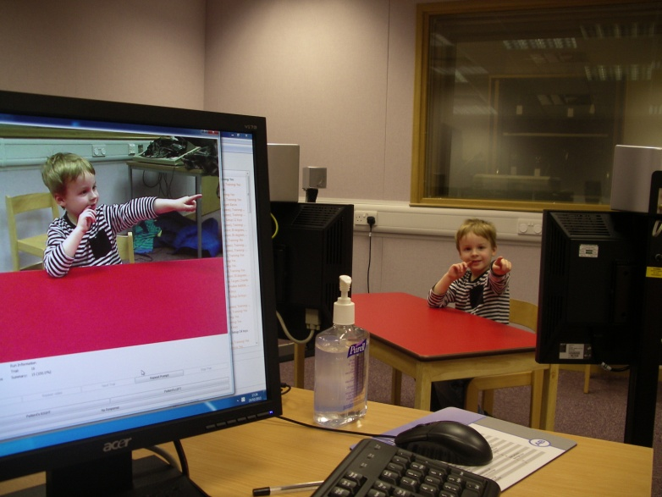
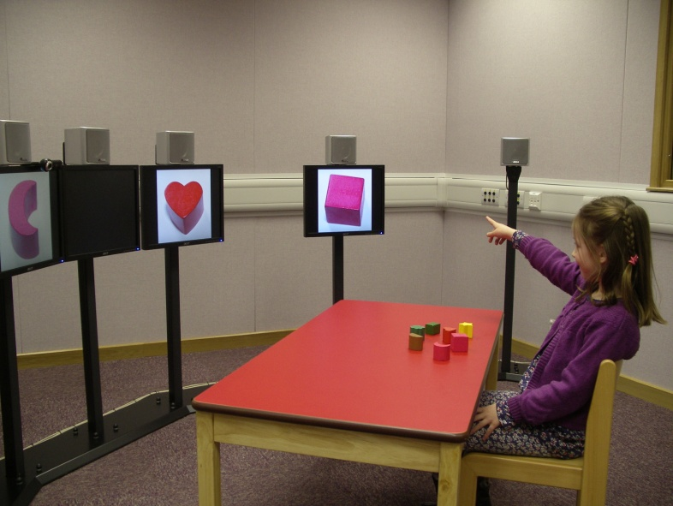
ABC-York Crescent of Sound: Test Battery
The Left-Right Discrimination Test
The Toy Localisation Test
The Toy Discrimination Test (Spatial Release from Masking for Speech)
The BKB Sentence Test

Slide 15
Two ears better than one in background noise
Speech &
Noise
1st
2nd
N = 14
Speech
1st
2nd
Noise
Speech
1st
2nd
Noise

Slide 16
Left / Right Discrimination

Slide 17
Summary of Outcomes
Two non-users
Two thirds of children have achieved open-set sentence understanding using the 2nd implant alone by 12 months
Functional listening ability improves over time
Localisation ability
Listening in background noise

Slide 18
Conclusions
Flexible approach to rehabilitation support, particularly targeting 9-11 age group
Recognition of long-term commitment and motivation is essential
Child
Parents
Co-operation from local professionals

Slide 19
Thank You

